Slide 1
S.HAJAYKUMAR
Final Project

Slide 2
autoencoder for image compression

Slide 3

AGENDA
Problem Statement
Project Overview
Who are the end users?
Your solution and its value proposition
The Wow in your solution
Modelling
Results

Slide 4

PROBLEM STATEMENT
With the increasing amount of digital media being produced and shared, efficient storage and transmission of images have become crucial. Image compression techniques aim to reduce the size of image data while preserving its essential features. In this project, we will explore the use of autoencoders, a type of neural network, for image compression.

Slide 5

PROJECT OVERVIEW
A more imaginative and adaptable approach to creating models with greater complexity is provided by the Keras Functional API. A model that performs multiple supervised prediction types (such as regression and classification predictions) introduces a certain level of complexity. Used libraries :
Pandas – An open-source library to read and manipulate datasets. Here it was used to read the CSV file which contained pixel values for the image
Numpy – An open-source library with functions for high-level mathematical calculations as well as handling data that spans multiple dimensions
Matlplotlib – An open source library which is used to visualize our data and losses in our prediction model
Sklearn – This library consists of pre-defined functions and evaluation metrics that help in data preprocessing, model performance evaluation and model initialization.
Tensorflow – Developed by Google, It provides many methods to interpret data but mainly focuses on training and inference of Neural Networks

Slide 6


WHO ARE THE END USERS?
A more imaginative and adaptable approach to creating models with greater complexity is provided by the Keras Functional API. A model that performs multiple supervised prediction types (such as regression and classification predictions) introduces a certain level of complexity. To develop a model with regression and classification capabilities, we will dissect a comparable situation.
The end users of an image compression system using autoencoders could vary depending on the specific application and context. Here are some potential end users:
General Consumers
Professional Photographers
Web Developers
Medical Imaging Professionals
Satellite and Remote Sensing Experts

Slide 7
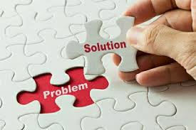
YOUR SOLUTION AND ITS VALUE PROPOSITION
Efficient Resource Utilization: Our system enables users to make the most out of limited storage capacity and bandwidth resources by compressing images without sacrificing quality. This translates to reduced storage costs, faster data transfers, and smoother user experiences across various platforms and applications.
Streamlined Data Handling: With our image compression solution, users can streamline their data handling processes, whether it's archiving large volumes of images, transmitting data over networks, or conducting complex analysis tasks. By minimizing the size of image datasets while preserving essential visual features, our system facilitates faster processing and more efficient utilization of computational resources.
Enhanced User Experience: By ensuring that compressed images maintain high-quality visual content, our solution enhances the overall user experience in applications ranging from photo sharing platforms to medical imaging systems. Users can enjoy faster load times, smoother streaming experiences, and clearer image representations, leading to increased satisfaction and engagement.

Slide 8
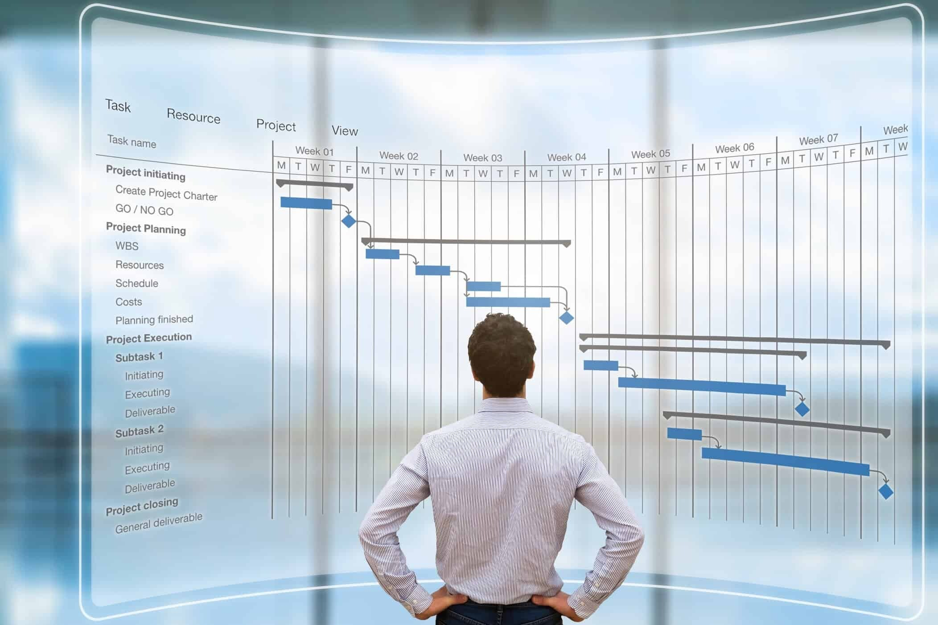
Proposition:
Our image compression solution leverages advanced autoencoder technology to maximize compression efficiency while preserving image quality. By seamlessly integrating neural network techniques, we enable users to optimize resource usage, accelerate data processing, and elevate user experience. Embrace our proposition to drive innovation and gain a competitive edge in image management.

Slide 9


THE WOW IN YOUR SOLUTION
Unmatched Compression: Achieve superior compression while maintaining quality.
Real-time Processing: Experience lightning-fast compression and decompression
Adaptive Learning: Continuously optimize compression techniques.
Protects user privacy through techniques like federated learning
9

Slide 10
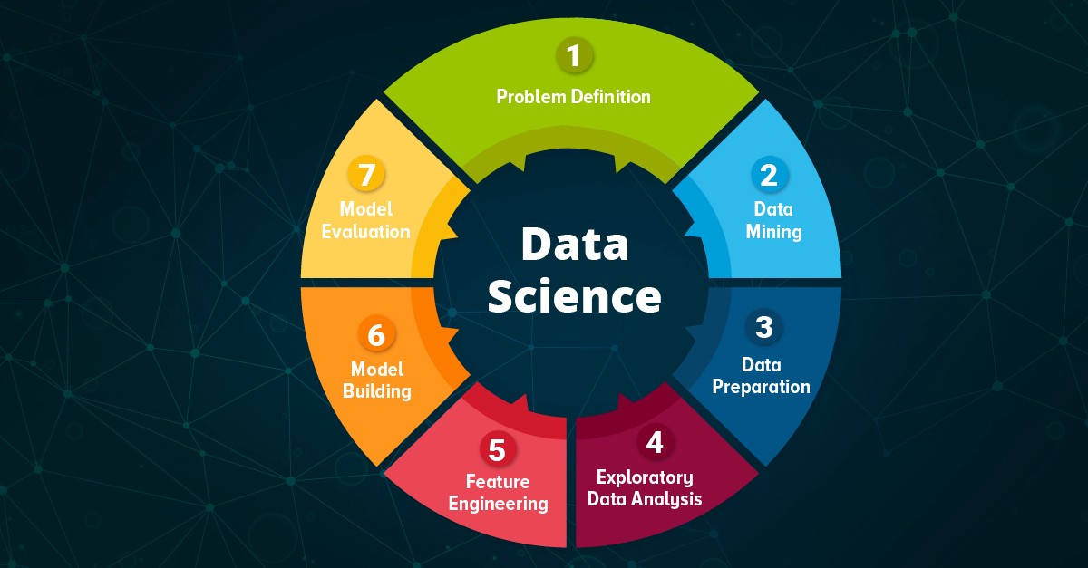
Exploratory Data analysis:
10

Slide 11
CONCLUSION:
In conclusion, our image compression solution stands at the forefront of innovation, offering unmatched compression efficiency, real-time processing capabilities, adaptive learning functionalities, and universal compatibility. With superior quality preservation, lightning-fast compression speeds, continuous optimization through advanced machine learning techniques, and seamless integration across platforms, our solution redefines the standards for image management in today's digital landscape. Embrace our solution to unlock new possibilities, drive innovation, and gain a competitive edge in image compression technology.

